Slide 1
Convolutional Neural Networks: Intuition, Detail and Applications
Speaker: Kangqi Luo
2015-11-04
Notes:
CNN: powerful model, especially in the image & speech recognition task
CNN has been applied in NLP fields
Lots of paper related with NN (CNN, RNN, LSTM …) to deal with classification
and we have GPU
so I decide to introduce these stuff.

Slide 2
Content
Classification Overview
Neural Networks
From NN to CNN
Real Example in NLP field
Conclusion
Notes:
briefly introduce the classification problem
talk about structure of NN and CNN
show you a real example which CNN is used in NLP field
conclude my talk
1. more beneficial if you’re not quite familiar with NN
2. it’s an abstract topic, feel free to ask any question if you’re confused

Slide 3
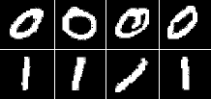
classification Overview
0?
1?
Classifier
……
9?
Notes:
Add a picture here.

Slide 4
Focus on Classification
POS tagging
Input: The quick fox jumps over the lazy dog
Output: DT JJ NN VBZ IN DT JJ NN
Picked from K possible POS tags
Hand-writing Digit Recognition
➔ 0
➔ 1
Notes:
two real classification problems
task: assign a POS tag for each word
it’s a classification problem, because the tag is picked from K possible POS tags
each pixel is describe as a integer value ranges from 0 to 64, indicating whether the pixel is white, gray or black.
task: recognize the real digit in the image

Slide 5
Different Models
Notes:
use POS tag to show the difference (HMM v.s. MEMM)
(Use graph to show the different idea) (arrow v.s. black rect.) (do not use x,y, but use p and w)
generative: how is the data generated (from hidden to observed)
discriminative: I do not care, but I just want to learn the functional representation of probability DIRECTLY.

Slide 6
Different Models
Generative
Naive Bayesian
Hidden Markov Model
Discriminative
SVM
Max Entropy Model (Logistic, Softmax)
Conditional Random Field
Neural Network

Slide 7
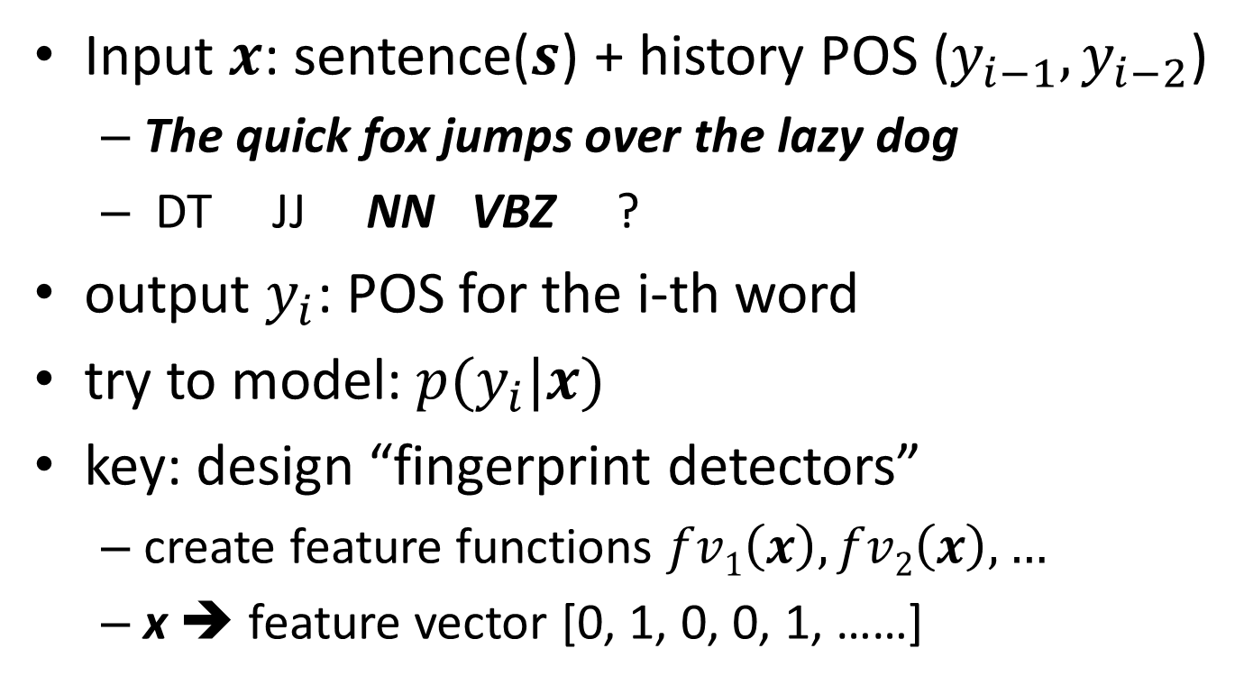
Close to NN: Softmax Regression
Input $x$: sentence($s$) + history POS ($y_{i−1},y_{i−2}$)
The quick fox jumps over the lazy dog
DT JJ NN VBZ ?
output $y_{i}$: POS for the i-th word
try to model: $p(y_{i}|x)$
key: design “fingerprint detectors”
create feature functions $fv1\left(x\right), fv2\left(x\right), …$
x ➔ feature vector [0, 1, 0, 0, 1, ……]
Notes:
softmax regression: simpler, close to NN
suppose tagging one by one, output: POS for the fifth word
input: sentence along with historical POS tags (we only consider the previous two tags in this case, that are NN and VBZ)
softmax reg. model try to define the cond. prob. as a function
the key in this step is to design several feature functions, which converts x into a feature vector represented by real values, I just use zero and one in this case.
I call them“fingerprint detectors”, because each feature function could detect some synt./sem. clues in the input.

Slide 8
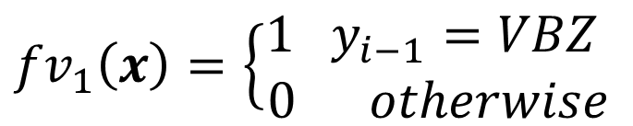
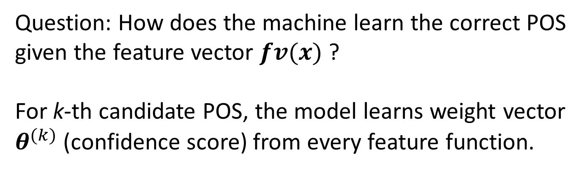
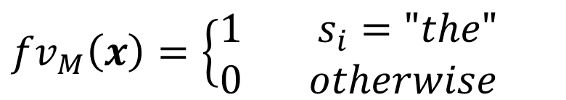
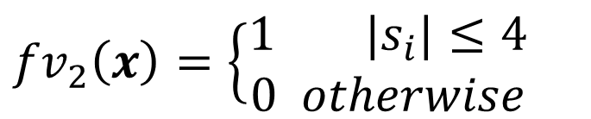
Feature Functions in Softmax
$${fv}_{1}\left(x\right)=\left\{\begin{aligned}1 y_{i−1}=VBZ \\ 0 otherwise\end{aligned}\right.$$
$${fv}_{2}\left(x\right)=\left\{\begin{aligned}1 |s_{i}|≤4 \\ 0 otherwise\end{aligned}\right.$$
$${fv}_{M}\left(x\right)=\left\{\begin{aligned}1 s_{i}="the" \\ 0 otherwise\end{aligned}\right.$$
Question: How does the machine learn the correct POS given the feature vector $fv(x)$ ?
For k-th candidate POS, the model learns weight vector $θ^{(k)}$ (confidence score) from every feature function.
Notes:
1. just define some feature functions. (the last fv, fv_M)
2. indicate whether ………
>>> for each candidate POS, the model will learn a vector of parameters theta, which captures the confidence score for every feature function

Slide 9

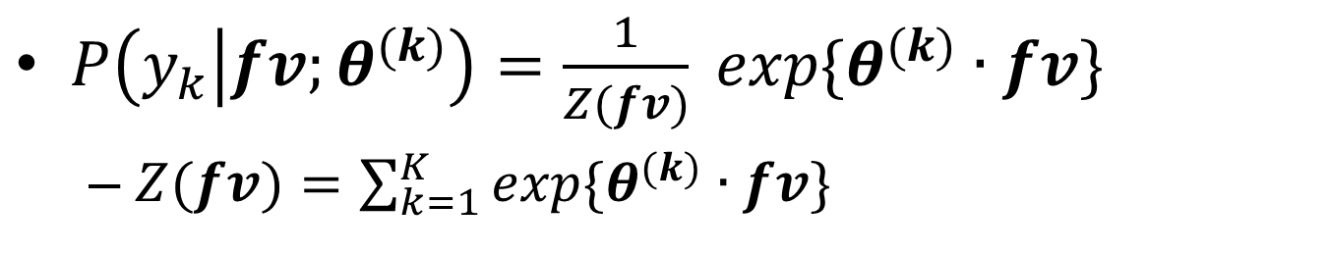



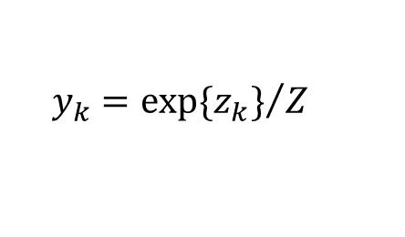



Softmax Regression
$P\left(y_{k} | fv;θ^{(k)}\right)=\frac{1}{Z(fv)} exp\{θ^{(k)}∙fv\}$
$Z(fv)=\sum_{k=1}^{K}{exp⁡\{θ^{(k)}∙fv\}}$
fv₁
3.2
$$θ^{\left(1\right)}$$
IN
$$y_{i−1}=VBZ$$
1
z₁
y₁
probability
of tags
feature vectors
fv₂
-0.8
$$|s_{i}|≤4$$
1
$$θ^{\left(k\right)}$$
z_{K}
y_{K}
JJ
fv_{M}
-5.2
$$z_{k}=θ^{\left(k\right)}∙fv$$
$$y_{k}={exp⁡\{z_{k}\}}/Z$$
$$s_{i}="the"$$
0
| Linear | normalization |
Notes:
then the we measure the cond. prob. of y_k based on feature vectors and the corresponding parameter theta_k
don’t worry about the formula, the following figure shows how it works.
input fv: feature vectors of some case, output y: cond. prob. for each class
recap the previous example and feature functions, obviously we have fv1 = 1, ……
z_k represents the confidence score of assigning the k-th POS tag for this case, which is a linear comb. between fv and theta.
the step from z to y is just a normalization, turning confidence scores into probs.
In terms of training, we generate a loss function based on conditional probability for each training data, and adjust weight theta by minimizing the loss functions
the final weight shows the association between a semantic clue and a canidate POS tag.

Slide 10
From softmax regression to neural network
Notes:
what’s the advantage of NN?
(do not need to assign features manually)

Slide 11
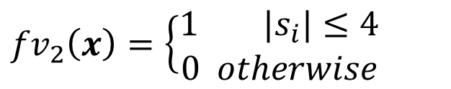
Shortcoming of Softmax
Feature functions are all hand crafted
Feature engineering
Time consuming
Couldn’t define complex feature functions
What is complex: human may not be able to describe the function well.
Example: How do we write down the function which captures a circle from the input pixels?
$${fv}_{2}\left(x\right)=\left\{\begin{aligned}1 |s_{i}|≤4 \\ 0 otherwise\end{aligned}\right.$$
Notes:
1. I must say there are shortcomings for softmax regression model.
2. designed by hand, this step is call feature engineering and it’s really time consuming
3. couldn’t define complex feature functions if even human is not able to describe it well.
4. ex., in the digit recognition task, it’s useful to detect circles in the image,
5. but how do we just write down a feat. func. that captures a circle ?

Slide 12
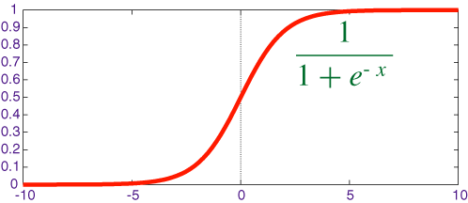





Structure of a Single Neuron
Similar with Softmax Regression
$f_{θ}\left(x\right)=sigmoid\left(θx\right)=1/{(e^{−θx}+1)}$
x₀=1
$$θ_{0}$$
Raw input
data
x₁
$$θ_{1}$$
x₂
$$θ_{2}$$
$$f_{θ}(x)$$
$$θ_{N}$$
Represents a complex and non-linear feature function
x_{N}
Notes:
1. a neuron is the most basic structure in NN
2. the neuron takes N variables x1~xn as input (with an additional x0=1),
3. by assign weights theta on each edge, the neuron produces the output variable by a non-linear function f.
4. Actually, the function f applies sigmoid function over the linear combinations between theta and x, which is similar in Softmax Regression Model. (this function is called active function, but never mind)
5. as we can see, sigmoid function is a non-linear function ranges from 0 to 1.
6. intuition is: a neuron represents a complex & non-linear feature function with x as input, parameterized by theta.

Slide 13







Combine Neurons into Network
Recap: A neuron as feature function
x₀=1
$$θ^{\left(1\right)}$$
h₁
$$h_{θ}^{\left(1\right)}\left(x\right)$$
x₁
h₂
$$h_{θ}^{\left(2\right)}\left(x\right)$$
x₂
$$θ^{\left(2\right)}$$
h_{M}
$$h_{θ}^{\left(M\right)}\left(x\right)$$
x_{N}
$$θ^{\left(M\right)}$$
$$fv\left(x\right)=[h1, h2, …, hM]$$
input layer (N)
hidden layer (M)
Notes:
1. recap the one neuron represents one feature function
2. we build several parallel neurons and combine them together into a network
3. in this example, there are M different neurons, forming a two-layer structure:
4. two layers:
a) input layer: N+1 variables
b) hidden layer: M variables representing an M-dim feature vector (but hidden)
5. actually we don’t know what features they are, unless we train the model

Slide 14



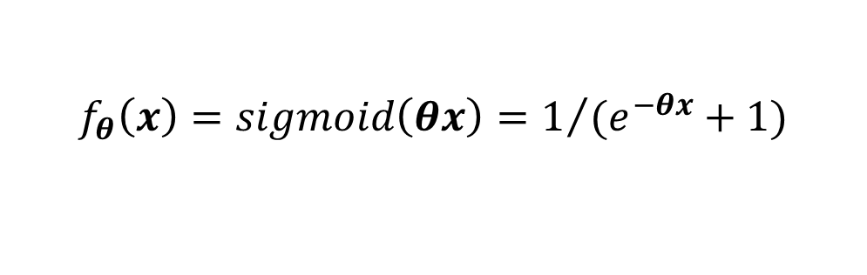

Add Output Layers
$$f_{θ}\left(x\right)=sigmoid\left(θx\right)=1/{(e^{−θx}+1)}$$
$$h_{m}=f_{θ}^{\left(m\right)}\left(x\right)$$
$$z_{k}=f_{φ}^{\left(k\right)}\left(h\right)$$
x₀=1
h₀=1
$$φ^{\left(1\right)}$$
z₁
y₁
$$θ^{\left(1\right)}$$
h₁
x₁
z₂
y₂
x₂
h₂
z_{K}
y_{K}
x_{N}
h_{M}
| non-linear | non-linear | normalization |
input layer (N)
hidden layer (M)
output layer (K)
Notes:
1. at last, we add output layers to finish the building of a typical NN.
2. the output layers are similar with softmax, but a little different
3. z_k also indicates the confidence score, but computed by the non-linear function f, parameterized by some other weights phi.
4. y_k is the normalized cond. prob. of z_k, which is consistent with Softmax
5. In summary, cond. prob. of y_k given x is a complex non-linear function with x as input, paramterized by theta and phi.
6. training is still not the point of my talk: also adjust weight by minimizing some loss function, “Back Prop.”
7. and note that, there could have multiple hidden layers, that’s a deep neural network.

Slide 15
NN in Digit Recognition
x_{n}: [0,64) integer indicating brightness of the n-th pixel
y_{k}: (0,1) real value, indicating the prob. of k-th digit given the image
x₀=1
h₀=1
z₁
y₁
x₁
h₁
z₂
y₂
x₂
h₂
z_{K}
y_{K}
x_{N}
h_{M}
h_{m}: (0,1) real value of the m-th hidden feature, capturing some particular shape
Notes:
xx layer has xx variables, each one is a real number / integer ranging from (a, b), xxxxxx

Slide 16

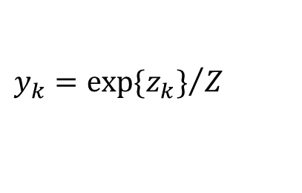


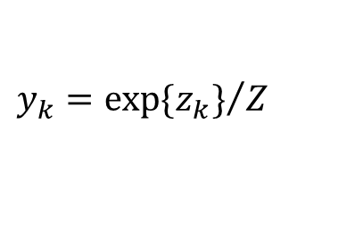
| manual | linear | normalization |
x₁
fv₁
Softmax
Regression
z₁
y₁
x₂
fv₂
z_{K}
y_{K}
x_{N}
fv_{M}
$$z_{k}=θ^{\left(k\right)}∙fv$$
$$y_{k}={exp⁡\{z_{k}\}}/Z$$
inputs (N)
features (M)
outputs (K)
$$h_{m}=f_{θ}^{\left(m\right)}\left(x\right)$$
$$z_{k}=f_{φ}^{\left(k\right)}\left(h\right)$$
$$y_{k}={exp⁡\{z_{k}\}}/Z$$
x₀
h₀
Neural
Network
z₁
y₁
x₁
h₁
z_{K}
y_{K}
x_{N}
h_{M}
| non-linear | non-linear | normalization |
Notes:
Directly compare structure between softmax and NN
the biggest difference is that, we do not need to design features any more, but learned from training data
feature function is complex & non-linear, which is more expressive than what in Softmax model

Slide 17

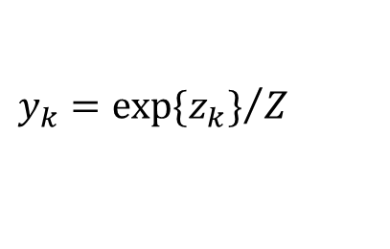


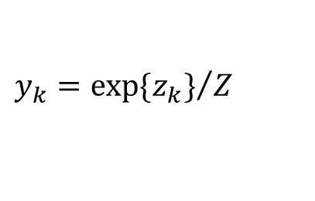
Quiz 1: How many different parameters are there in each model ?
x₁
h₁
Softmax
Regression
z₁
y₁
x₂
h₂
M*K
z_{K}
y_{K}
x_{N}
h_{M}
$$z_{k}=θ^{\left(k\right)}∙h$$
$$y_{k}={exp⁡\{z_{k}\}}/Z$$
inputs (N)
features (M)
outputs (K)
$$h_{m}=f_{θ}^{\left(m\right)}\left(x\right)$$
$$z_{k}=f_{φ}^{\left(k\right)}\left(h\right)$$
$$y_{k}={exp⁡\{z_{k}\}}/Z$$
Neural
Network
x₀
h₀
z₁
y₁
x₁
h₁
(N+1)*M+
(M+1)*K
z_{K}
y_{K}
x_{N}
h_{M}
Notes:
Quiz: How many different parameters are there in these two different classifiers？
M*K (N+1)*M + (M+1)*K

Slide 18
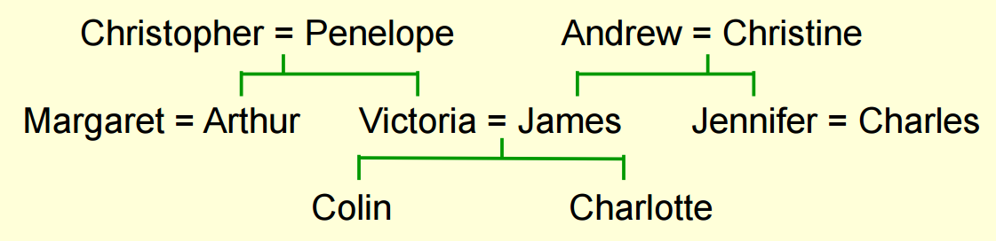
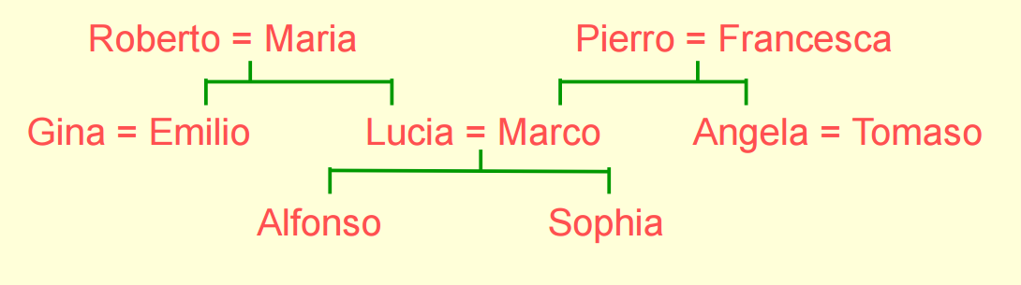
Example: Learning From Family Tree
Notes:
1. look at another real example: learning from FTs
2. the knowledge: two family trees with the same structure
3. 12 American people, 12 Italian people

Slide 19
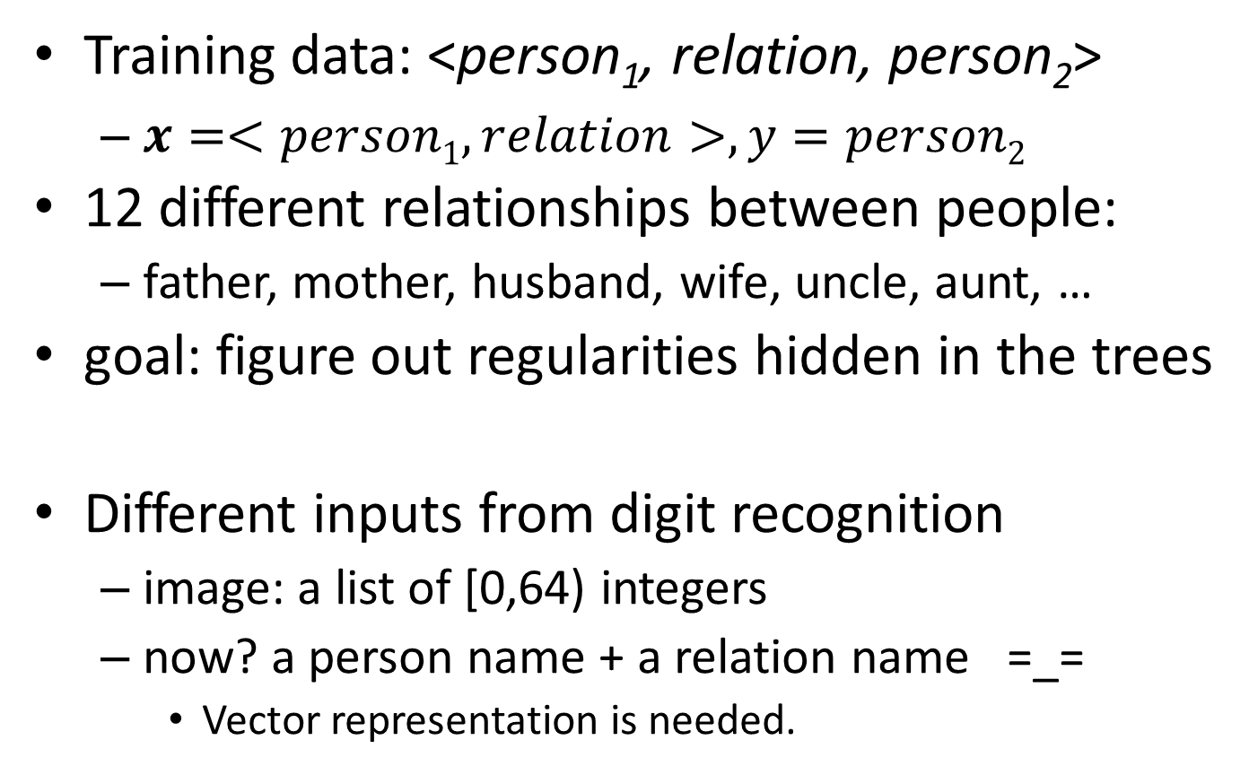
Example: Learning from Family Tree
Training data: <person₁, relation, person₂>
$x=<person1,relation>, y=person2$
12 different relationships between people:
father, mother, husband, wife, uncle, aunt, …
goal: figure out regularities hidden in the trees
Different inputs from digit recognition
image: a list of [0,64) integers
now? a person name + a relation name =_=
Vector representation is needed.
Notes:
1. besides the family tree, we have some training data with <p1, r, p2> triples, explicitly showing the relationship between two people.
2. if modeled as classification task, x is a <p1, r> pair, y is the other person.
3. in this case, we want to show you that NN could learn regularities from the family tree, even you do not provide any useful information about features in advance (gender, generation, tree branch)
4. input is a little different from digit. rec.
5. now how to represent the input?

Slide 20
Family Tree Example: Build the NN
converting to the final vector rep.
24
feat. of the target person
feat. capturing <p,r> pair
feat. of person
feat. of relation
person_{i}: [0, 0, …, 0, 1, 0, …, 0]
6
24
12
vector rep. of one person
vector rep. of one relation
Notes:
1. Now I show you how the NN is built in this case.
2. in the input layer, we need to use vector representations to represent one individual person and relation
3. the vector rep. of person has length 24, when representing the i-th person, the i-th element is 1, and the remaining are 0. The same as vector rep. of relations.
4. then we build the first hidden layer, capturing features of a person and features of a relation.
5. second hidden layer: capturing features of <p, r>
6. third hidden layer: converting <p,r> into features of p2
7. last: output layer
we omit (x0=1) here for every neuron.
And I emphasize: we doesn’t create any features manually, but we build this NN to let the machine learn useful hidden features. so we focus on this part of NN, and show you what kinds of feature functions does it learns.
As I mentioned before, each neuron corresponds to a feature function, parameterized by weights on the neuron.

Slide 21

Family Tree Example: Feat. Visualize
feat. of person
+3.2
-1.5
+0.8
vector rep. of person
Visualize block for incoming weights
Notes:
white block: positive
black block: negative
large block: large abs value

Slide 22
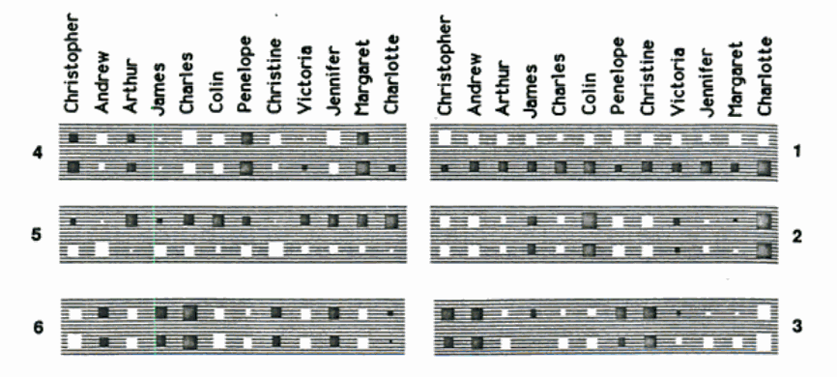
Family Tree Example: Feat. Visualize
Arthur
Colin
Christine
Victoria
Charlotte
Arthur
Colin
Christine
Victoria
Andrew
Jennifer
Andrew
Charlotte
Christopher
Jennifer
James
Charles
Christopher
James
Penelope
Charles
Margaret
Penelope
Margaret
6
What does feature 1 try to represent ?
Answer: Nationality of a person
Positive: American
Negative: Italian
24
Notes:
1. show you 6 hidden features, each feature has 24 different weights, in each hidden feature, the top 12 blocks are the features for American people, and the bottom 12 blocks are the features for the equivalent Italian people.
2. since vector rep. of a person always have one active element (value = 1), each block represent the feature value of the corresponding person.

Slide 23
Family Tree Example: Feat. Visualize
Arthur
Colin
Christine
Victoria
Charlotte
Arthur
Colin
Christine
Victoria
Andrew
Jennifer
Andrew
Charlotte
Christopher
Jennifer
James
Charles
Christopher
James
Penelope
Charles
Margaret
Penelope
Margaret
6
What does feature 6 try to represent ?
Answer: Branch of the family tree
Positive: Left branch
Negative: Right branch
24
Notes:
show the graph here and make quizes

Slide 24
Family Tree Example: Feat. Visualize
Arthur
Colin
Christine
Victoria
Charlotte
Arthur
Colin
Christine
Victoria
Andrew
Jennifer
Andrew
Charlotte
Christopher
Jennifer
James
Charles
Christopher
James
Penelope
Charles
Margaret
Penelope
Margaret
Quiz 2: What does feature 2 try to represent ?
Answer: Generation of the person
Large Positive/Negative: Oldest/Youngest generation
Intermediate: Middle generation
Notes:
show the graph here and make quizes

Slide 25
Convolutional neural network
M
0.85
0.10
S
Q
0.02
0.10
0.03
0.85
0.78
0.04
M
P
(P-S+1)(Q-S+1)
Notes:
what’s the advantage of NN?
(do not need to assign features manually)

Slide 26


Limit of Fully Connected Network
$$h_{m}=f_{θ}^{\left(m\right)}\left(x\right)$$
$$z_{k}=f_{φ}^{\left(k\right)}\left(h\right)$$
Neural
Network
x₀
h₀
z₁
y₁
x₁
h₁
(N+1)*M+
(M+1)*K
z_{K}
y_{K}
x_{N}
h_{M}
Considering the task of hand-writing digit recognition, what if the image goes larger?
Image Size: 96x96 ➔ 960x960 ?
N: 96² ➔ 960²
Almost 100M parameters (say, M=100)
Notes:
1. considering the size of parameters in NN
2. costs 100M parameters when M=100

Slide 27
Fully v.s. Locally Connected
Fully connected layer: feature functions are related to all input pixels
Really necessary?
What about extracting feature functions that only describe a small region of pixels??
Locally connected layer
connection is limited, but still many parameters
Is there a way to reduce more?
x₁
x₂
h₁
x₃
h₂
x₄
h₃
x_{N-1}
h_{M}
x_{N}
Notes:
1. global features are really necessary?
2. we may recognize the digit by horizontal lines, vertical lines, circles, intersections…
3. both features can be captured within a small region of pixels
4. so we build hidden features which only take some connected pixels as input.
5. look at the new figure, this is an example of locally connected layer. suppose the size of region is 3.
6. However, for each small region, we are not extracting only one feature (though what the figure depicted is 1)
(Need black board)
N*M ➔ S*(N-S+1)*M

Slide 28


Convolutional Layer
Important Intuition: Stationary
Necessary to learn diff. features capturing the curve shape, just because of the diff. location?
No!!
Locally Connected Layers, Feature Sharing
Notes:
1. therefore, we introduce a important intuition, called “stationary”
2. considering these two hand-writing digits, they are almost the same, except the location of “0”in the writing area.
3. yellow block as a local area with identical. Suppose each area has a neuron capturing a curve shape.
4. is it necessary for NN to learn two different features capturing this shape, just because they have different locations?
5. No! As we human, this position change won’t affect the recognizing result.
6. >>> This suggests that the features that we learn at one part of the image can also be applied to other parts of the image, and we can use the same features at all locations
7. therefore, in a convolutional layer, neurons are locally connected, and features are shared among diff. locations.

Slide 29








Convolutional Layer Structure
M
$$θ^{\left(M\right)}$$
$$θ^{\left(M\right)}$$
$$θ^{\left(M\right)}$$
$$θ^{\left(1\right)}$$
$$θ^{\left(1\right)}$$
$$θ^{\left(1\right)}$$
$$θ^{\left(M\right)}$$
$$θ^{\left(1\right)}$$
S
Q
P
Notes:
1. the detail showing
2. input layer: P*Q pixel
3. local area: square window of connected pixels
4. sliding the window, producing M neurons (M hidden features) for each local area.
5. feature sharing, so they share the same weights.

Slide 30
Convolutional Layer Structure
Quiz 3-1: How many different parameters are there in the conv. layer ?
Quiz 3-2: How many output variables are there in the conv. layer ?
3-1: M(S²+1)
3-2: M(P-S+1)(Q-S+1)
M
S
Q
P
Notes:
Note: we omit x0 in the graph

Slide 31



Final: Pooling Layer
Goal: merge lots of M-dim feature vector into a single one as output features.
Stationary again: aggregate the statistics of these features at various locations.
Max Pooling, Average Pooling
$$h_{m}=f_{θ}^{\left(m\right)}\left(x\right)$$
$$z_{k}=f_{φ}^{\left(k\right)}\left(h\right)$$
x₀
h₀
z₁
y₁
x₁
h₁
0.85
0.10
z_{K}
y_{K}
x_{N}
h_{M}
max pooling
0.02
0.10
0.03
0.85
0.78
0.04
M
(P-S+1)(Q-S+1)
Notes:
pooling
since we don’t care about the difference between locations, we could just aggregate the feature statistics at various locations.
For example, one could compute the mean (or max) value of a particular feature over a region of the image
in this example, we really care about the confidence that the image has the desired shape,
so we could perform Maximum operation over all local regions
returning a single feature value for this image as the confidence
these numbers are corresponded to the input image. (suppose we’ve learnt feature weights)

Slide 32
CNN in Natural language understanding
Representing Text for Joint Embedding of Text and Knowledge Bases
Notes:
what’s the advantage of NN?
(do not need to assign features manually)

Slide 33
Representing Text for Joint Embedding of Text and Knowledge Bases
Author: Kristina Toutanova, Danqi Chen, Patrick Pantel, et al.
Venue: EMNLP 2015
Objective: Learn the embeddings of textual relation and on a uniform vector space
Final Goal: Knowledge Base Completion
Add new <e₁, r, e₂> triple into an incomplete KB
<Kangqi_Luo, place_of_birth, China>

Slide 34
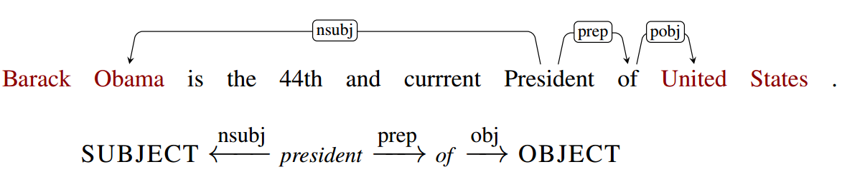
Modeled as Classification Problem
Knowledge base: FB15k-237
<e₁, r_{fb}, e₂> triples (subset of Freebase)
<e₁, r_{tx}, e₂> triples (ClueWeb12 + FB Annotation)
Training Data: Pos. & Neg. <e₁, r, e₂> triples
positives: coming from KB facts
negatives: randomly generated by close world assumption
Notes:
r_fb: Freebase relation
r_tx: natural language (dependency path)

Slide 35
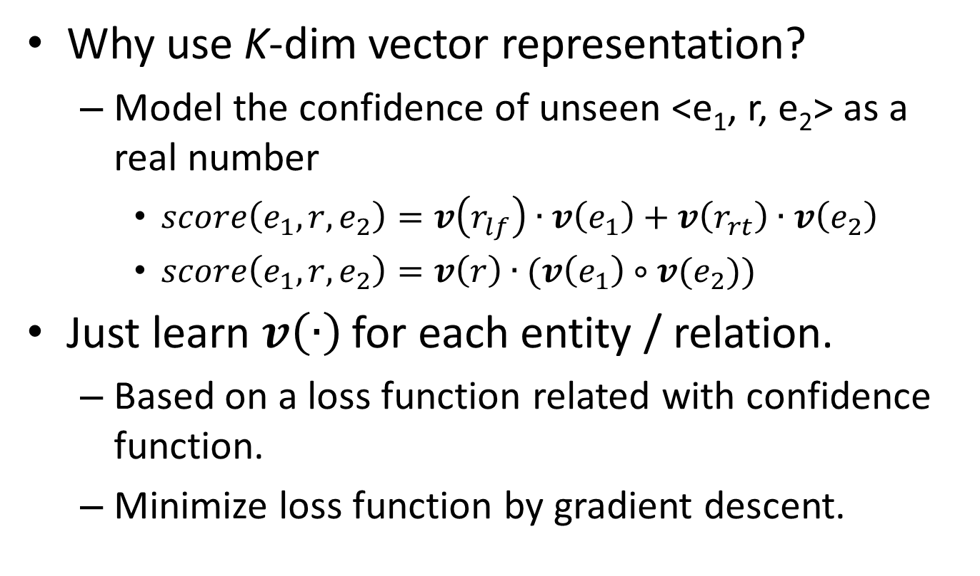
Modeled as Classification Problem
Why use K-dim vector representation?
Model the confidence of unseen <e₁, r, e₂> as a real number
$score\left(e_{1}, r,e_{2}\right)=v\left(r_{lf}\right)∙v\left(e_{1}\right)+v\left(r_{rt}\right)∙v\left(e_{2}\right)$
$score\left(e_{1}, r,e_{2}\right)=v\left(r\right)∙(v\left(e_{1}\right)∘v(e_{2}))$
Just learn $v\left(∙\right)$for each entity / relation.
Based on a loss function related with confidence function.
Minimize loss function by gradient descent.
Notes:
dot: element-wise muliplication

Slide 36
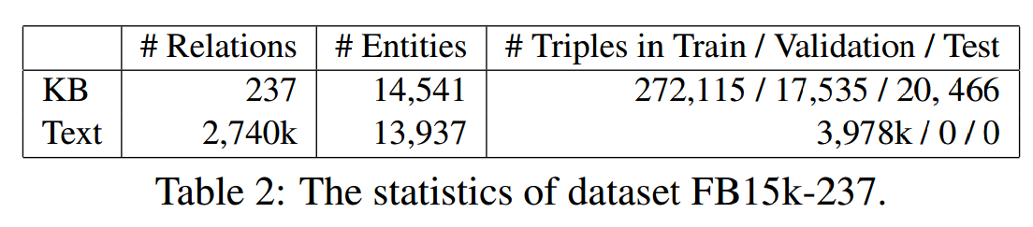
Facing Huge Number of Parameters
How many parameters shall we learn?
K parameters for each entity / relation.
There are too many different textual relation patterns!!
In fact, some relation patterns are really similar.

Slide 37
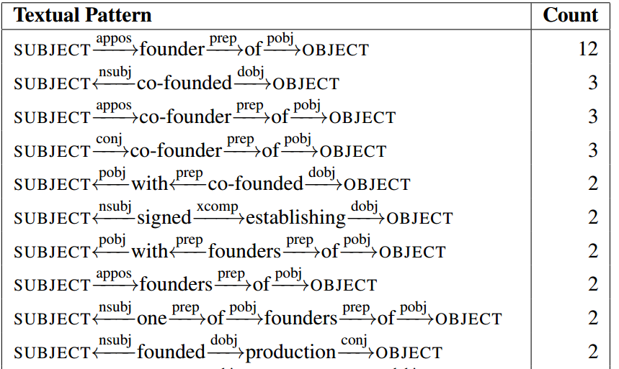
Mining Substructures under Pattern
Different dependency paths share substructures under a certain window.
Textual patterns occurring with <e₁, e₂> in FB relation org_founded.
Notes:
Sharing example

Slide 38
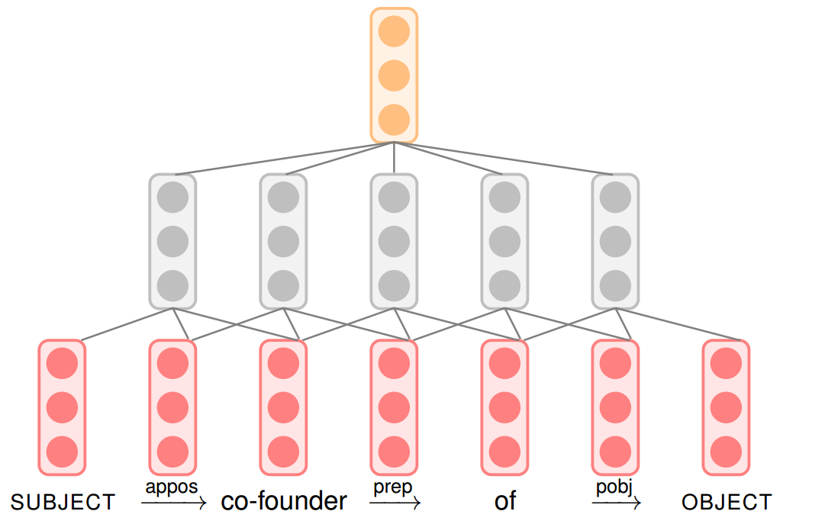


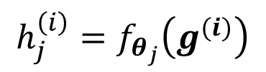

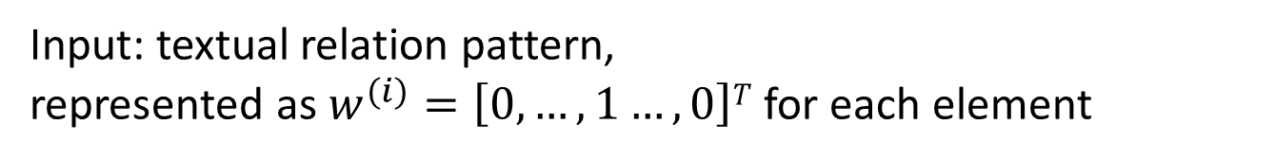
CNN: Modeling Feat. for a Pattern
Max
Pooling
Output: Embedding of whole pattern
$$r_{j}^{}=max⁡\{h_{j}^{\left(i\right)}\}$$
$$g^{(i)}=v^{(i−1)}⨁v^{(i)}⨁v^{(i+1)}$$
Conv. Layer
$$h_{j}^{\left(i\right)}=f_{θ_{j}}\left(g^{(i)}\right)$$
$$v^{(i)}=Vw^{(i)}$$
Input: textual relation pattern,
represented as $w^{(i)}=\left[0,…,1…, 0\right]T$ for each element
Notes:
CNN graph

Slide 39
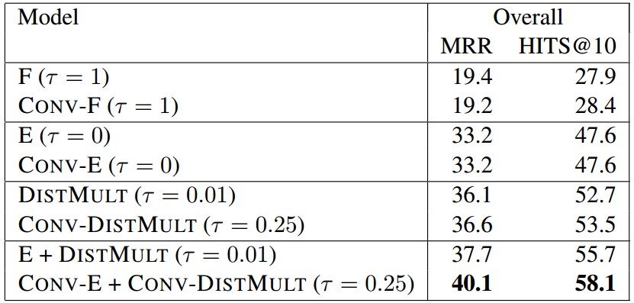
Evaluation Result
Results on FB15k-237 for KB+text inference, with basic models versus proposed CONV-augmented models.
Notes:
evaluation

Slide 40
Conclusion
NN provides the framework for mining flexible and more complex features.
Intuition for CNN: instead of global features, local features are also expressive, and more efficient.
“Stationary” property is a double-edged sword
Dramatically reduces the number of params.
Drop the location information
Don’t use CNN, if location does matters.
Notes:
Conclusion

Slide 41
THANKS for listening!!

